Slide 1

Kubernetes 101: Production-Workload Orchestration

Slide 2
Outline Day 1
Container concept (Recap)
Introduction to Kubernetes
System Architecture
Fundamental of Kubernetes
Pods, Container and Services
Daemon Sets and Replication Controller (RC)
Deployment/Replica-Set (RS) and Rolling update
Resource Management and Horizontal Pods Autoscaling (HPA)
Map and Secret
Jobs and Cron Jobs
Debug Log and Monitoring

Slide 3
Outline Day 2
Fundamental of Kubernetes (Con’t)
Map and Secret
Jobs and Cron Jobs
Debug Log and Monitoring
Ingress Network
Kubernetes in real world
Cluster Setup for Bare Metal
Orchestrator Assignment
nodeSelector
Interlude
Affinity
Taints/Tolerations

Slide 4
Pre-require
Windows 10 (64 bit)/ Mac OSX (64 Bit) with memory 8 GB
Intermediate understand for docker/compose and container concept
Google Cloud Account (Free for 300$) or other Cloud / Bare Meterial
LINE Account
Basic understand for network/load balance concept
Tool for editor (atom etc)
Tool for shell (putty / terminal etc)
Tool for transfer file (winscp / scp)
Internet for download / upload image

Slide 5
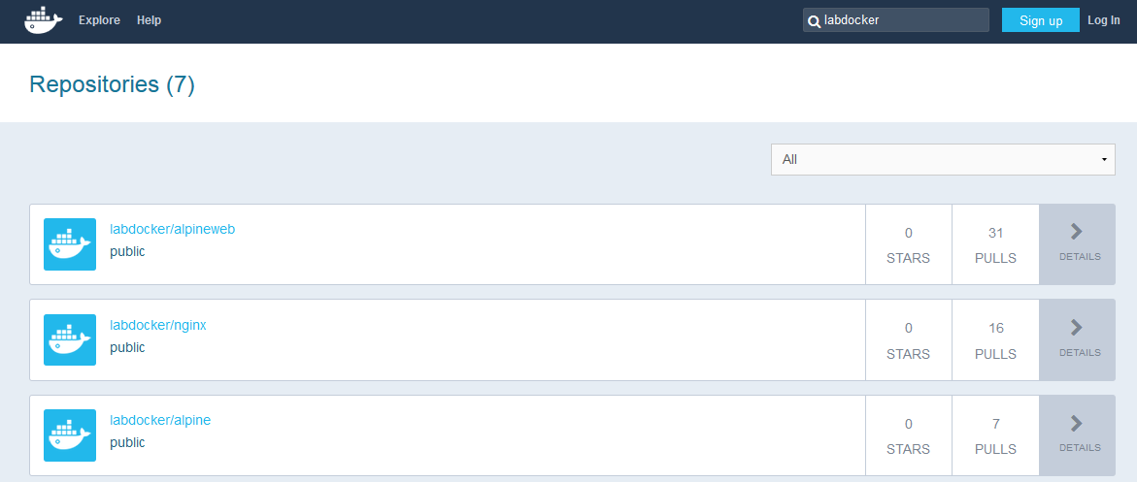
Lab Resource
Repository for lab

Slide 6
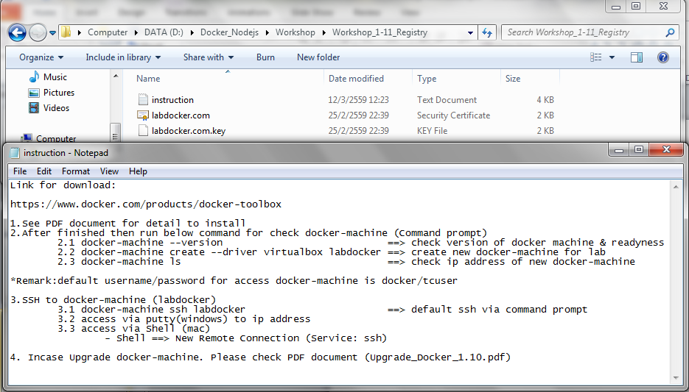
Lab Resource
Software in lab

Slide 7
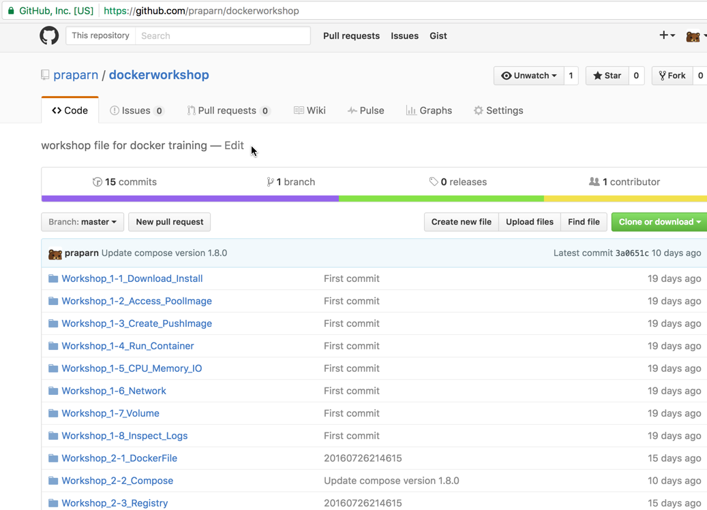
Lab Resource
Download on Google Drive
https://drive.google.com/open?id=0ByjcBsedtQQiMzVCdVp5emxpeDg
Download on GitHub
git@github.com:praparn/kubernetesLab.git

Slide 8
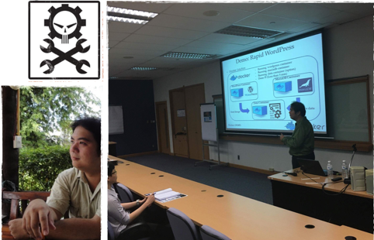
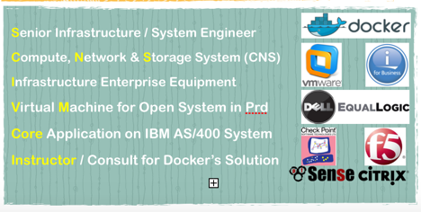

Slide 9
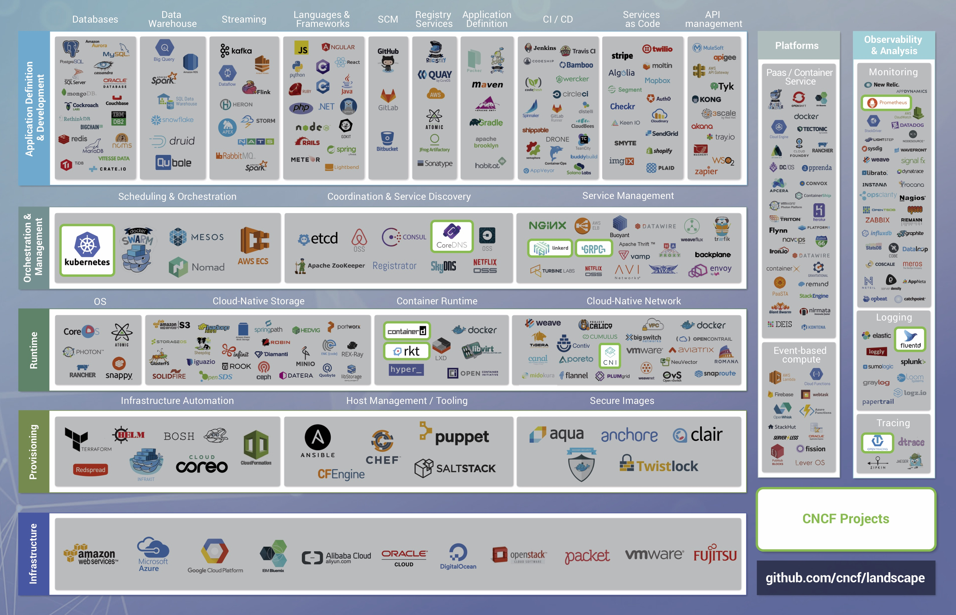
Landscape of the world now

Slide 10
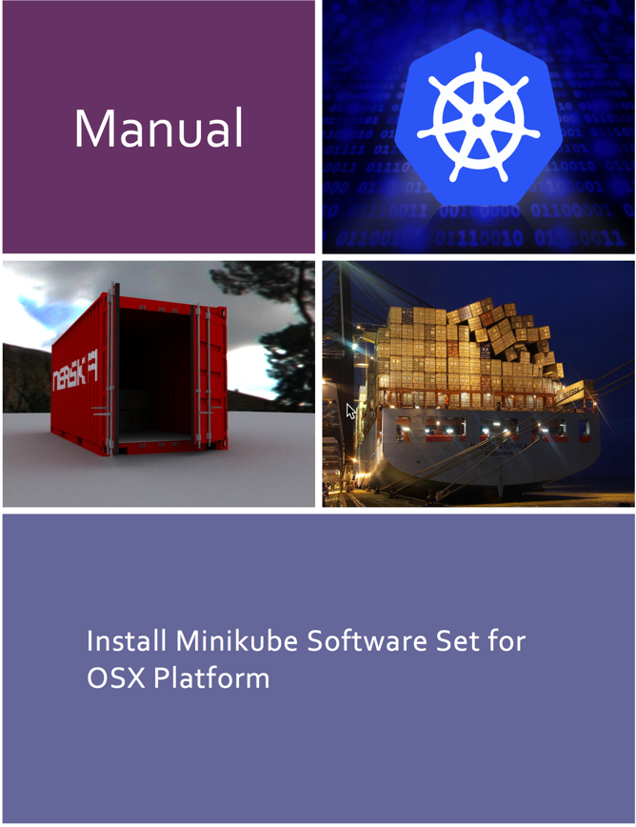
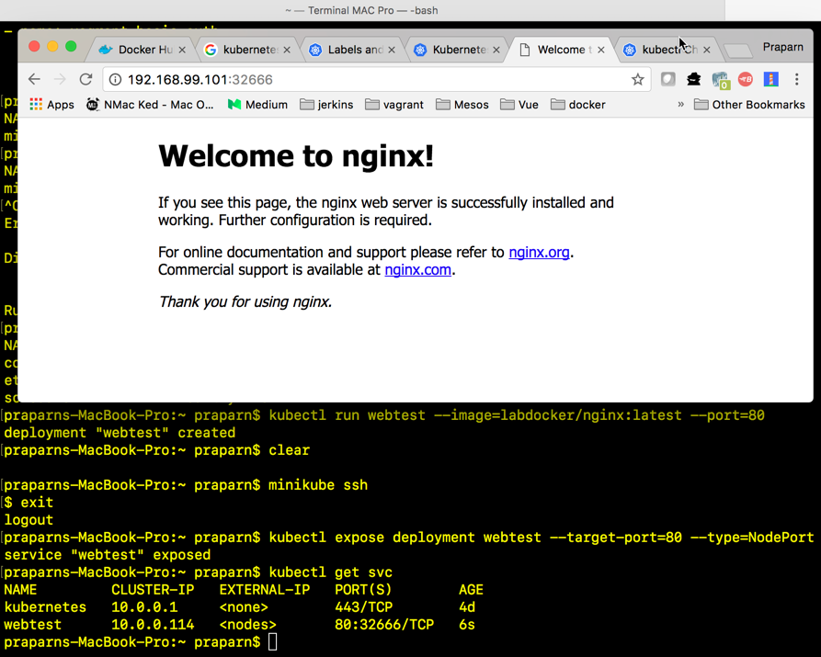
Workshop 1.1: Install Kubenetes

Slide 11

Container Principle

Slide 12
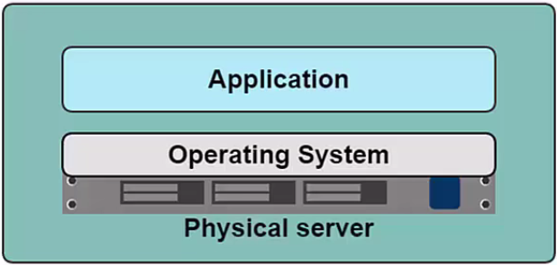
Container Principle

Slide 13

Existing Technology
Production Environment (Best design)
Day 1: Application 1: Implement
Web Server
Web Service
Database
- Apache 2.20 Web Server
- PHP 5.5 Engine
- Larevel 4.1 Framework
- IIS 8
- .Net FrameWork 3.5
- MariaDB 5.1
Day 2: Application 2: Need to implement
Need PHP 7.0 ?
MariaDB 10.1.14 (Need search feature on 10.1)
Problem ?
Possible to upgrade PHP to 7.0 ? / How to test existing application ?
What effect to MariaDB upgrade ?

Slide 14
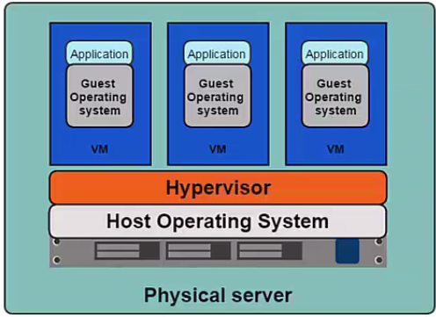
Container Principle

Slide 15
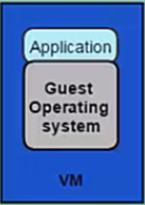
Container Principle
Production Environment
Day 1: Application 1: Implement
Web Server
Web Service
Database
- Apache 2.20 Web Server
- PHP 5.5 Engine
- Larevel 4.1 Framework
- IIS 8
- .Net FrameWork 3.5
- MariaDB 5.1
Day 2: Application 2: Need to implement
Need PHP 7.0 ?
MariaDB 10.1.14 (Need search feature on 10.1)
So… The problem still exist.

Slide 16
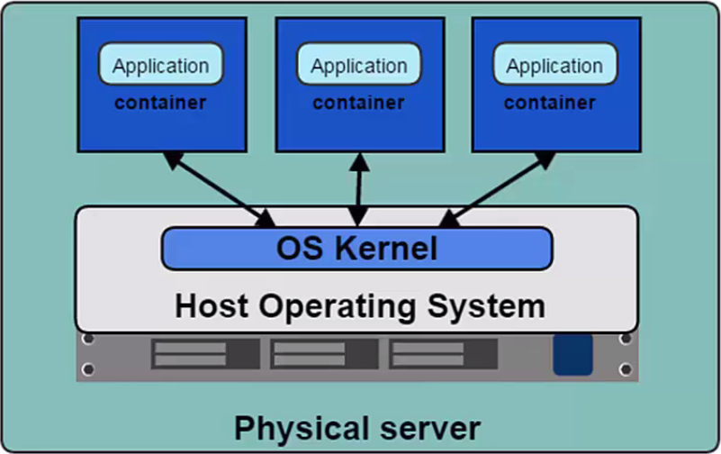
Container Principle

Slide 17
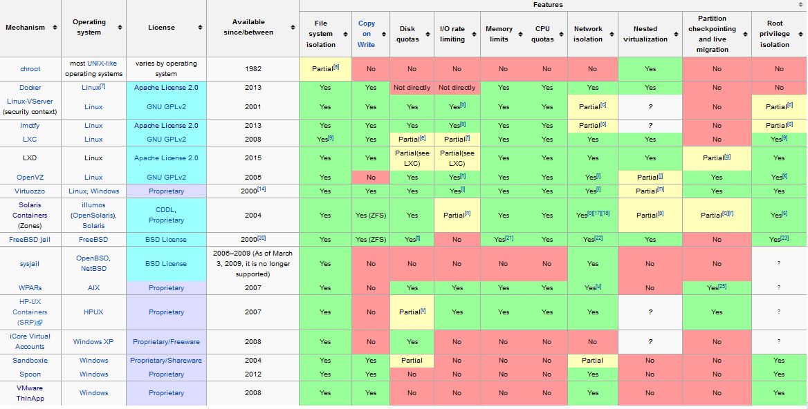
Container Principle
Reference: https://en.wikipedia.org/wiki/Operating-system-level_virtualization

Slide 18
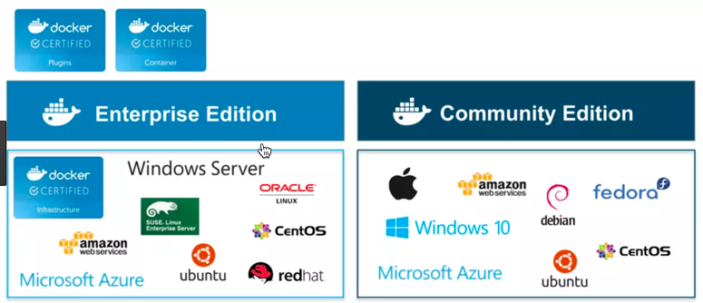
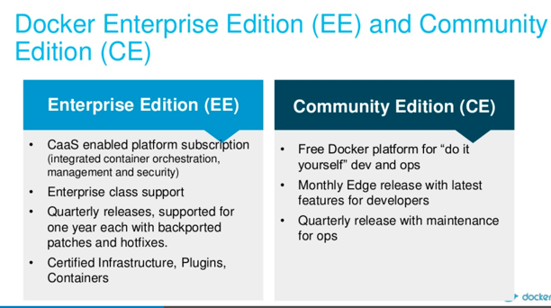
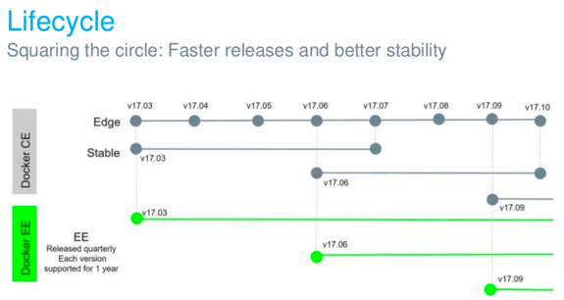
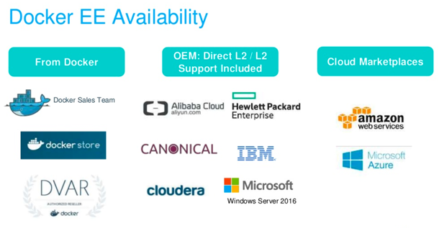
Container Principle
Ref: https://blog.docker.com/2017/03/docker-online-meetup-recap-docker-enterprise-edition-ee-community-edition-ce/

Slide 19
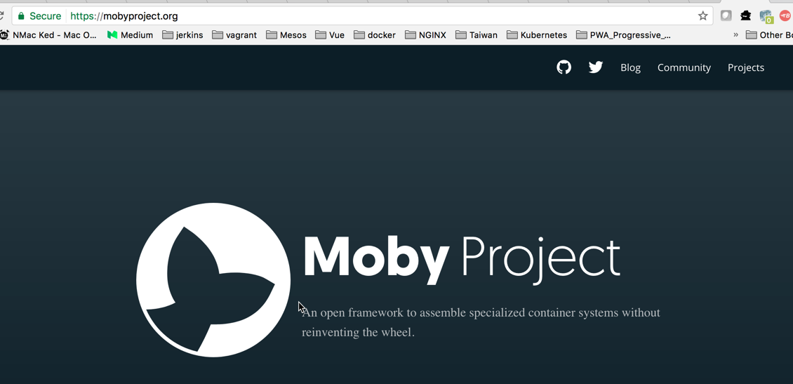
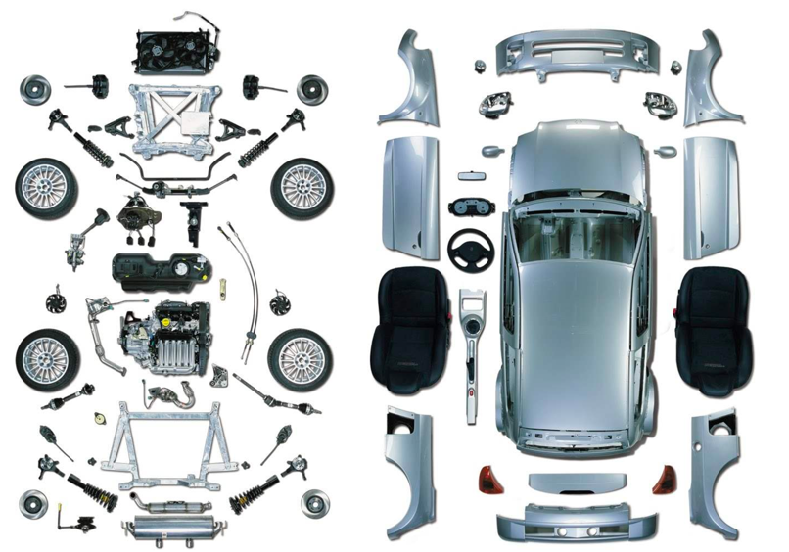
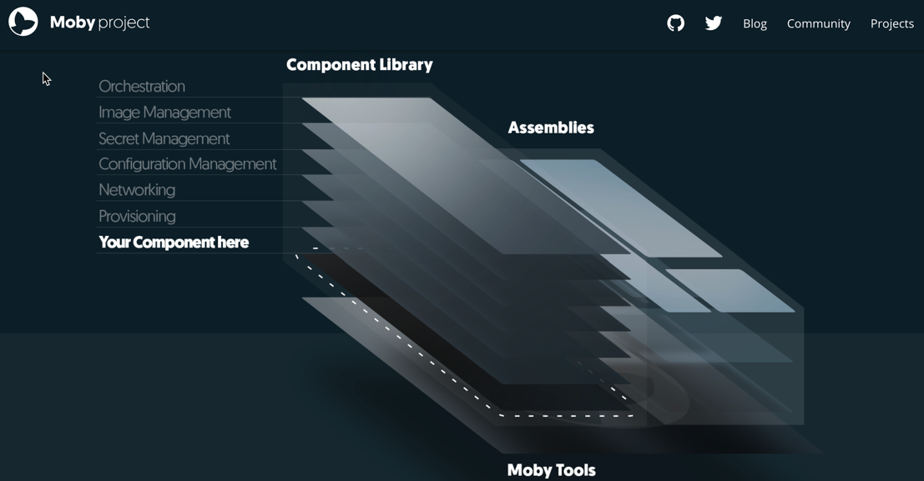
Container Principle

Slide 20
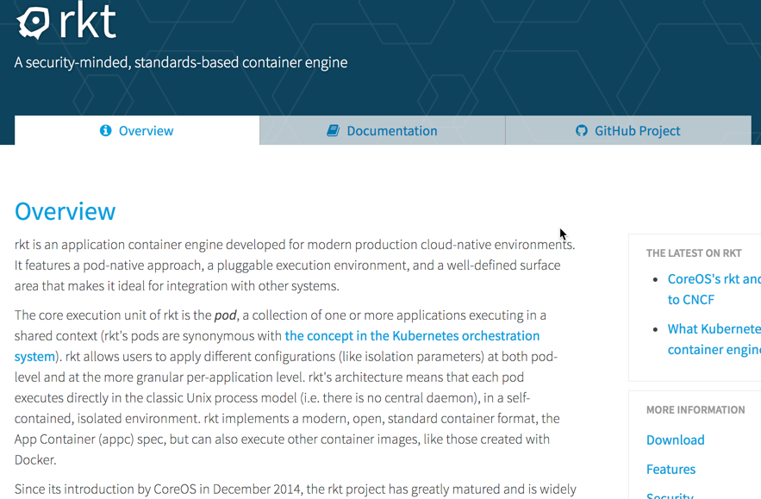
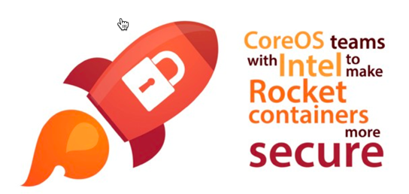
Container Principle

Slide 21
Introduction to Kubernetes

Slide 22
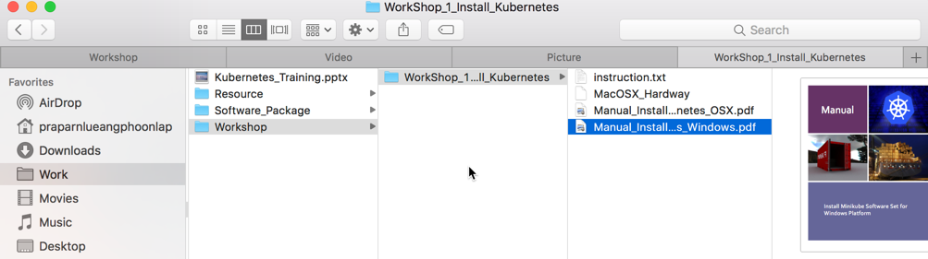
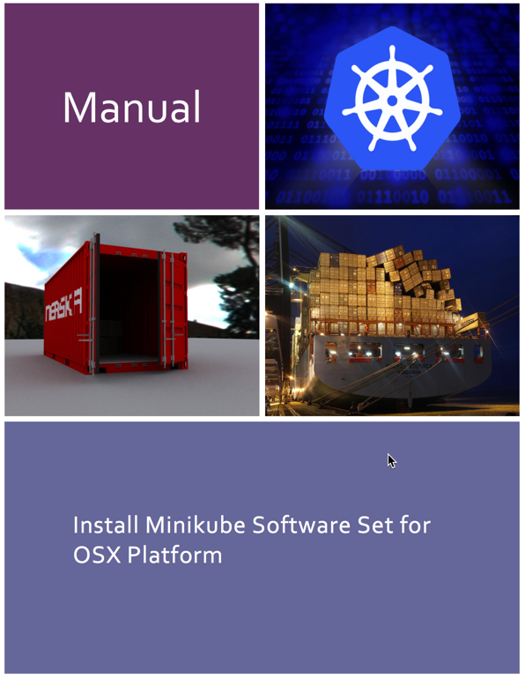
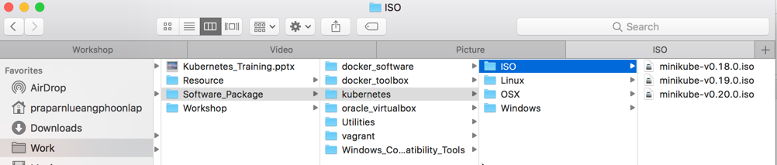
Workshop Day1: Unit 1
Install lab prerequisite and minikube

Slide 23
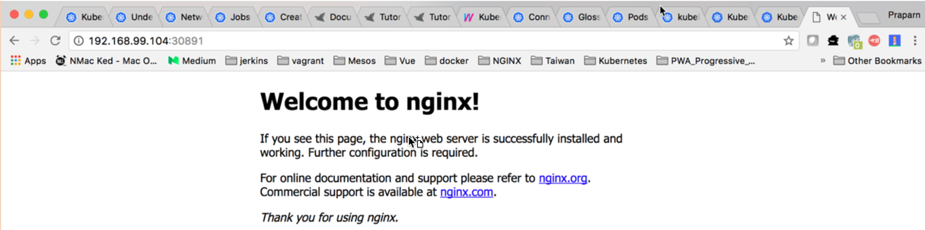
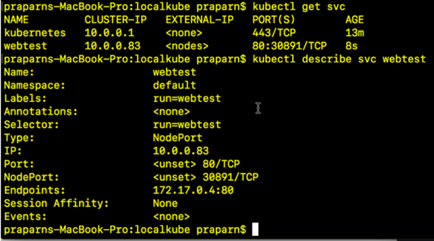
Workshop Day1: Unit 1

Slide 24
Introduction to Kubernetes
What news in 1.7.0 version
“Kubernetes is an open-source system for automating deployment, scaling, and management of containerized applications”
Greek word mean “Pilot”
Short word “K8s” (K+8 character +s)
Design and Reference from Google's Borg system
Donate to ”CLOUD NATIVE COMPUTING FOUNDATION”
Ref: Current release version
1.6.0 (Exist Stable Version)
1.7.0 (Stable Version: 1/7/2017)
1.8.0-alpha.1 (Alpha Control)
Ref:https://en.wikipedia.org/wiki/Kubernetes, https://en.wikipedia.org/wiki/Kubernetes

Slide 25
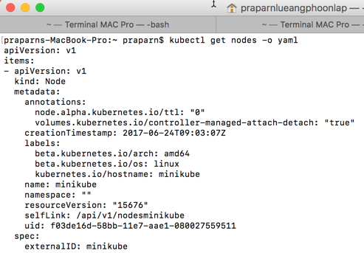
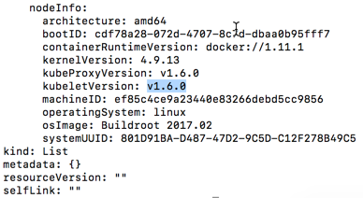
Introduction to Kubernetes
Check kubernetes version
kubectl get nodes -o yaml

Slide 26
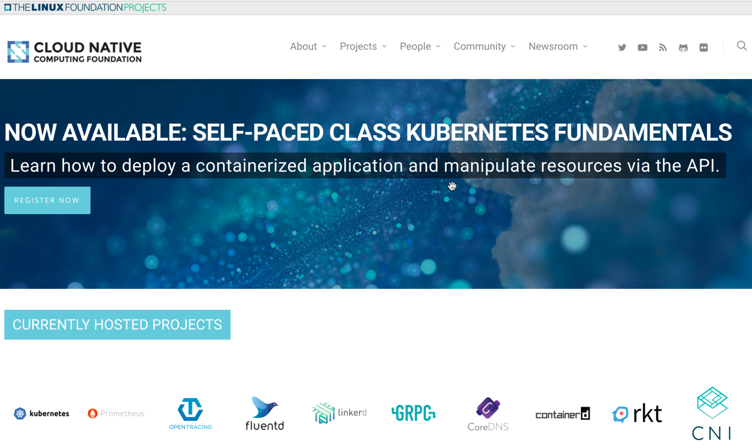
Introduction to Kubernetes

Slide 27

Introduction to Kubernetes
What is Orchestration (Computing)?
Align business request with Application/Data/Infrastructure
Centralize management for:
Resource Pool
Automated Workflow
Provisioning
Scale Up/Down
Monitoring
Billing
etc
Ref: https://en.wikipedia.org/wiki/Orchestration_(computing)

Slide 28
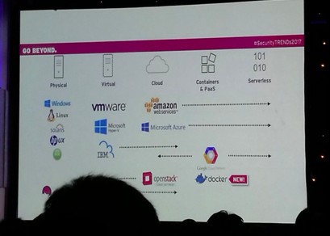
Introduction to Kubernetes
But why Container Orchestration ?
Container Platform is next generation that partner/beat existing virtualize technology
Easy to build-ship-run on dev and production
Zero Configure
Suitable for Microservice architecture
Good for application, Good for business (Win/Win !!!)

Slide 29
Introduction to Kubernetes
But why we need Container Orchestration ?
Production environment is cluster system
Microservice maintain connect was required
Application state-full will run on stateless architecture
Application scale up/Down was required
Many native command/shell for maintain container in production environment
etc

Slide 30


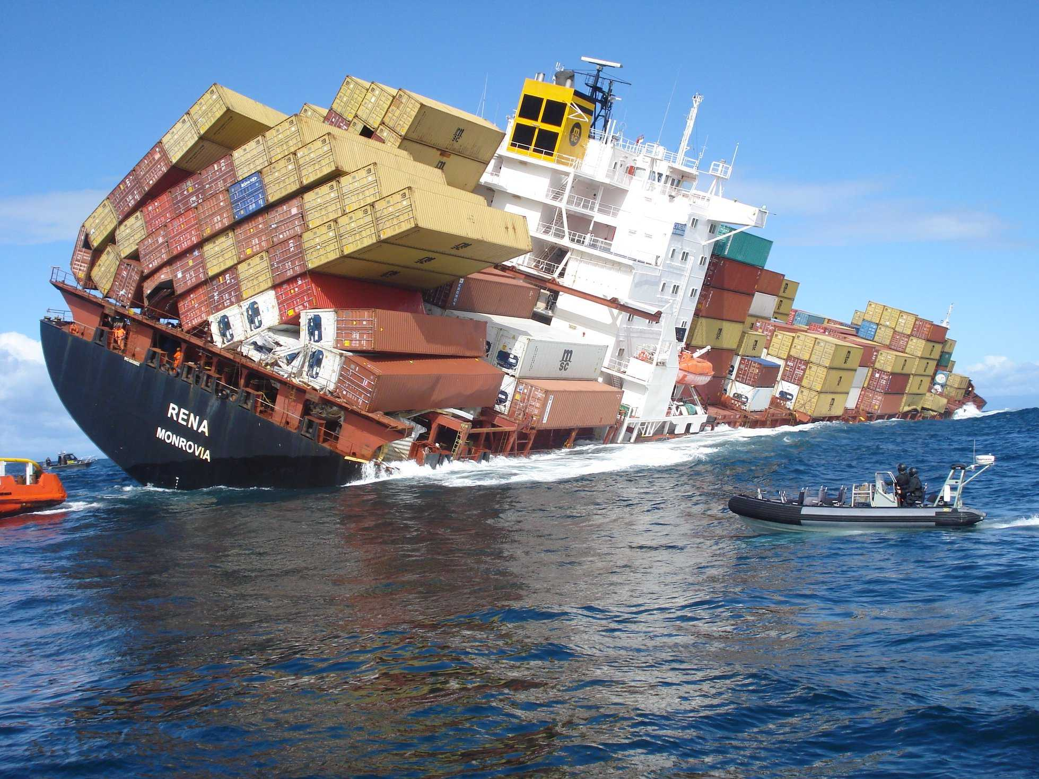
Introduction to Kubernetes

Slide 31
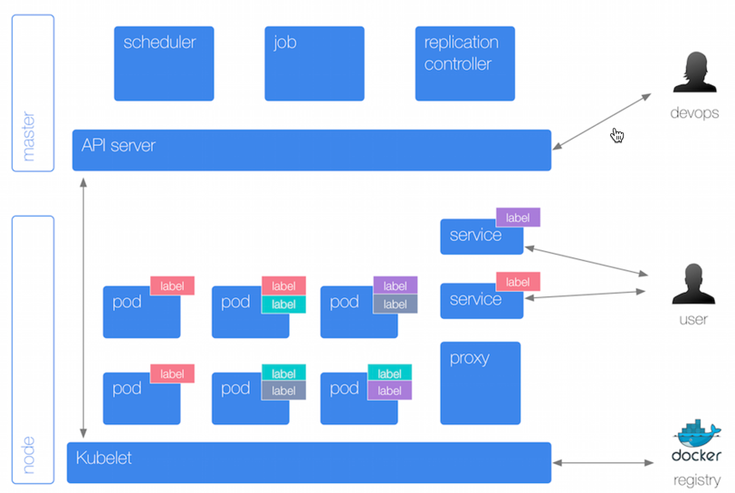
Introduction to Kubernetes

Slide 32
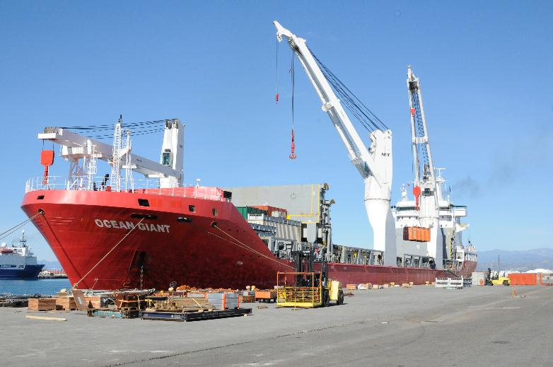
Introduction to Kubernetes
Key Feature
Automatic binpacking
Horizontal Pod Autoscaling (HPA)
Automated rollouts and rollbacks
Storage orchestration
Self-healing
Service discovery and load balancing
Secret and configuration management
Batch execution

Slide 33
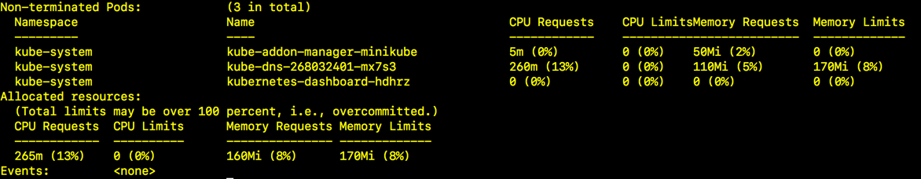
Introduction to Kubernetes
Automatic binpacking
CPU/Memory’s utilization can define on Pods (Smallest Unit of Kubernetes)
Schedule will select the node by ensure all resource is enough for running Pods as required
If reach memory limit
Current Pods will be terminate (Kill)
If restart flag was set. Kubenetes will try to restart Pods on other node
If reach cpu limit
Schedule will not kill Pods and waiting for it back to normal state
Check available node resource by command: kubectl describe node

Slide 34
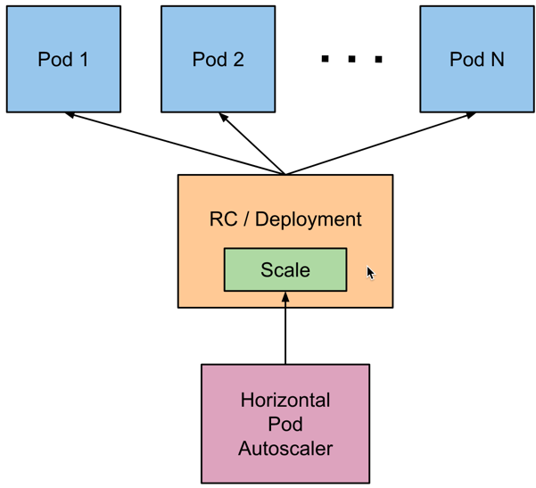
Introduction to Kubernetes
Horizon Pods Autoscaling (hpa)
Talk with RC (Replication Controller) for complete task
Automatic scaling Pods’s number base cpu’s utilization
Support multiple criteria (metric) for scale (Alpha feature)
Support customize criteria (metric) for scale (Alpha feature)
Looping check resource’s utilization every 30 seconds (default)

Slide 35
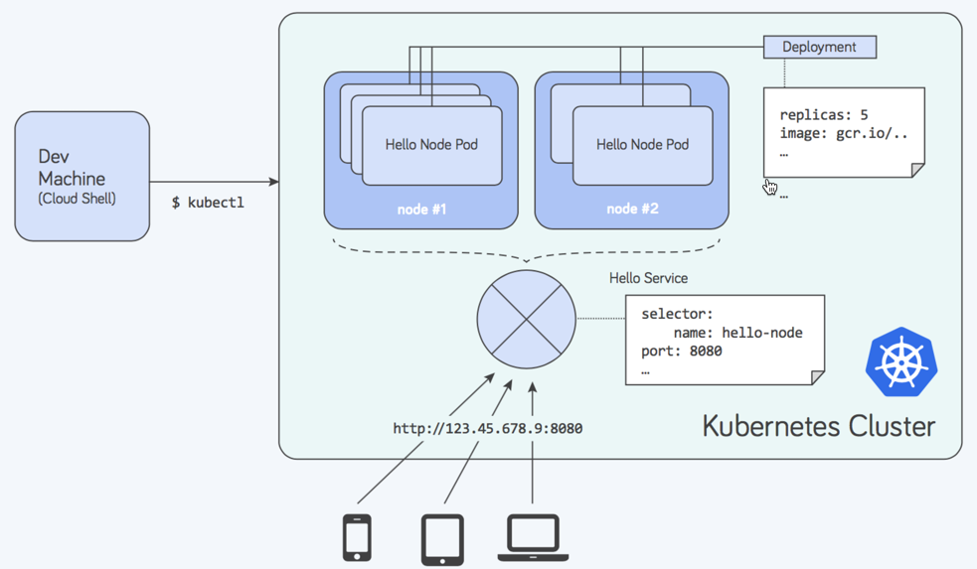
Introduction to Kubernetes
Automated Rollout and Rollbacks
Update will base on Pod’s template
Rollout existing deployment with all remain replicas number as desired
If rollout is success. New version will be provision until success
Rollback will possible with single command
Rollout process can pause/resume as need

Slide 36
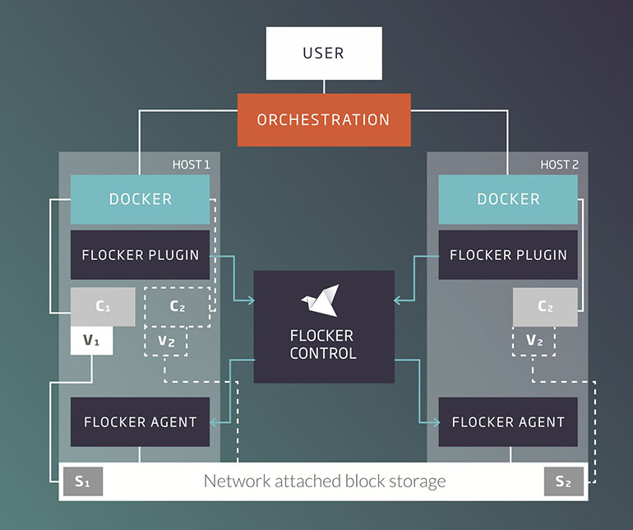
Introduction to Kubernetes
Storage Orchestrator
Support several storage type:
Local Storage
Network Storage (NFS, iScsi, Gluster, Ceph, Cinder, Flocker)
Cloud Storage (AWS, GCE, Azue Disk etc)

Slide 37

Introduction to Kubernetes
Self-healing
Replication Controller (RC) will maintain unit of Pods as design (not to much (kill) and not to few (create)
Full-fill Pods on every failure case with automatic by system

Slide 38
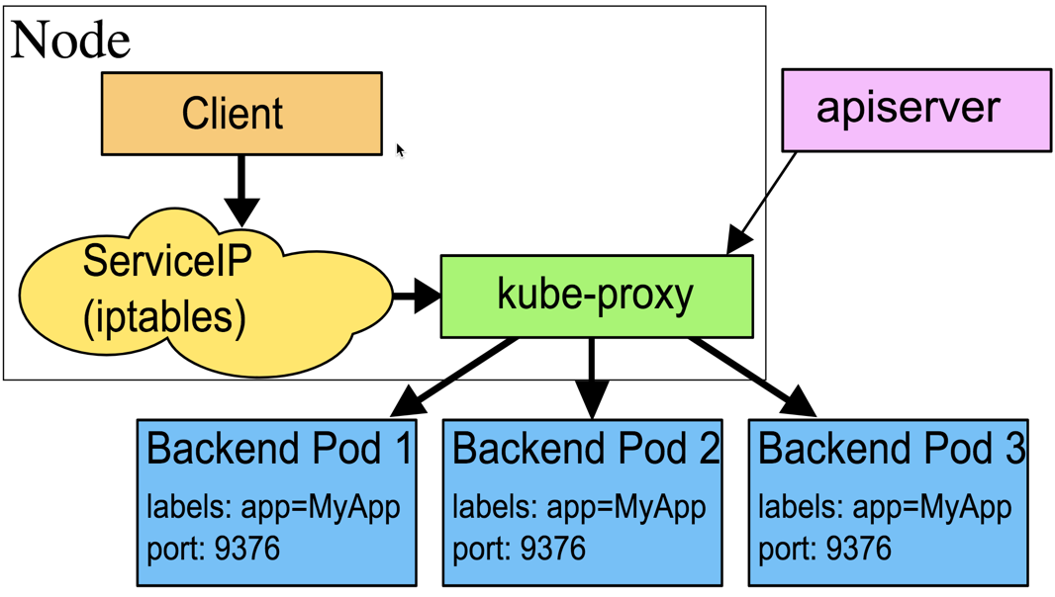
Introduction to Kubernetes
Service Discovery and Load Balancing
Service will act like “connector” for client need to connect with Pods
Discovery will use for service to look “Pods” by environment variable or dns service
Support load balancing between multiple Pods (replica)

Slide 39
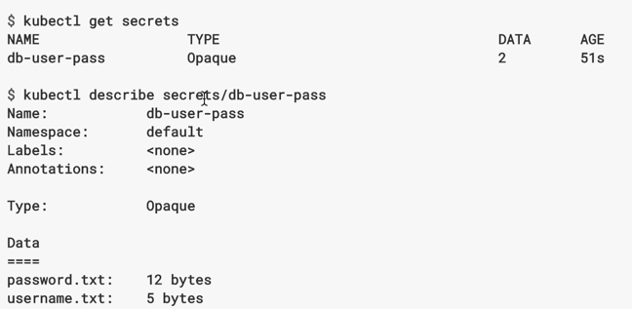
Introduction to Kubernetes
Secret and Configuration Management
Kubernetes can keep confidential data (such as username/password) for running application on encrypt format.
Can reference on Pods instead plan text configuration.

Slide 40
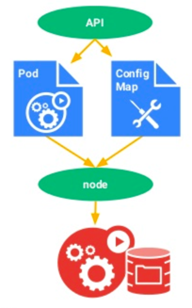
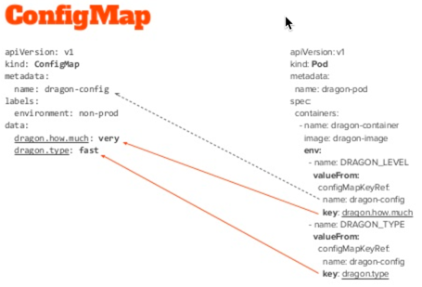
Introduction to Kubernetes
Secret and Configuration Management
Sometime we have a many configuration that need to specify on each application, But it should be change every time need.
Idea is create configuration file (ConfigMap) for define all configuration that reference on Pods instead

Slide 41
Introduction to Kubernetes
Batch Execution
A job will response some kind of batch execute by create special Pods (Terminate when batch complete)
Normally kubernetes will use job for maintain many background process for cluster system such as Replication Controller (RC) will submit job for start new Pods when existing is fail or delete.
Type of Job
Non-parallel jobs
Parallel jobs with fix-completion
Parallel jobs with work queue

Slide 42
System Architecture

Slide 43
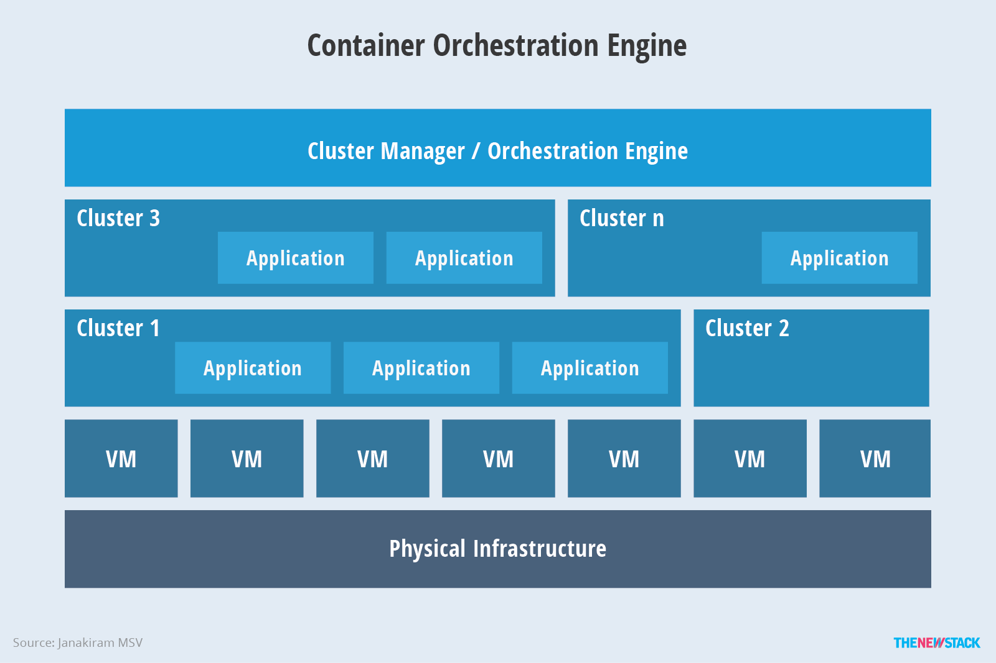
System Architecture
Ref: https://cdn.thenewstack.io/media/2016/11/Chart_02_Kubernetes-Architecture.png

Slide 44
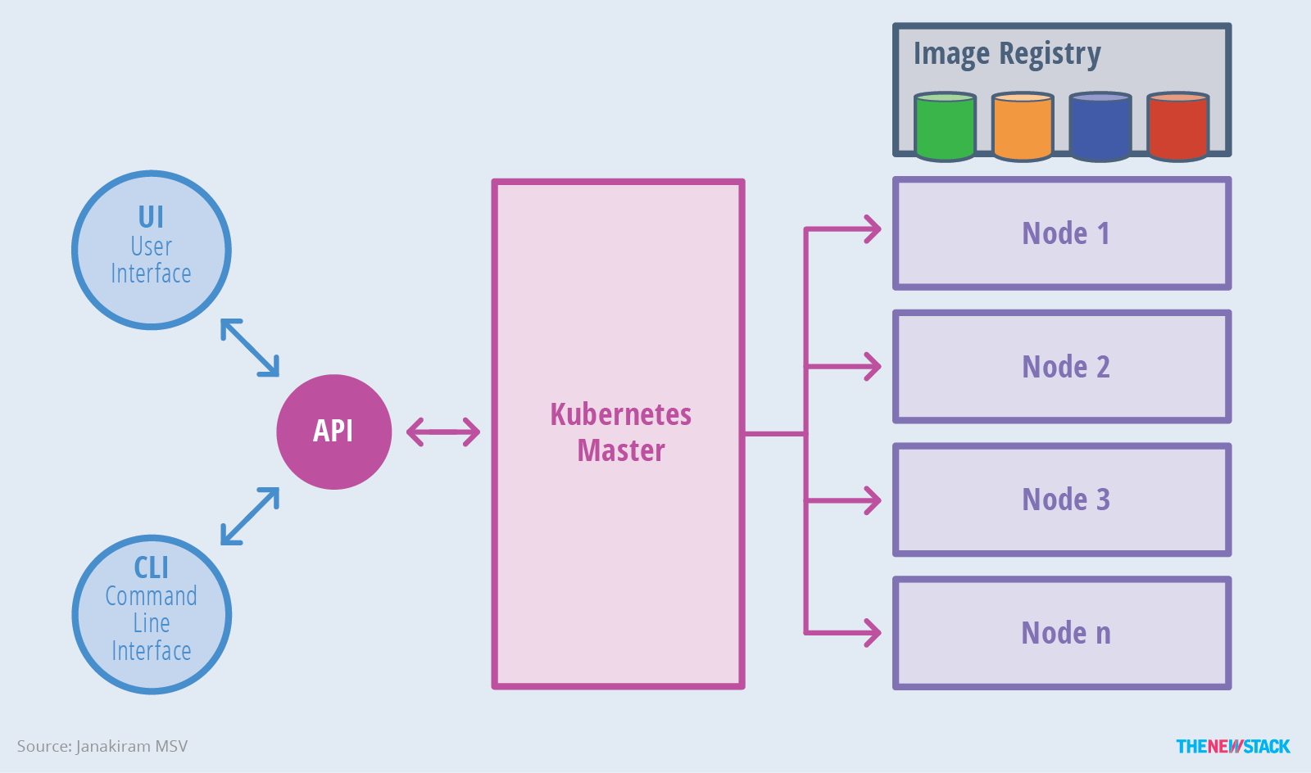
System Architecture
Ref: https://cdn.thenewstack.io/media/2016/11/Chart_02_Kubernetes-Architecture.png

Slide 45
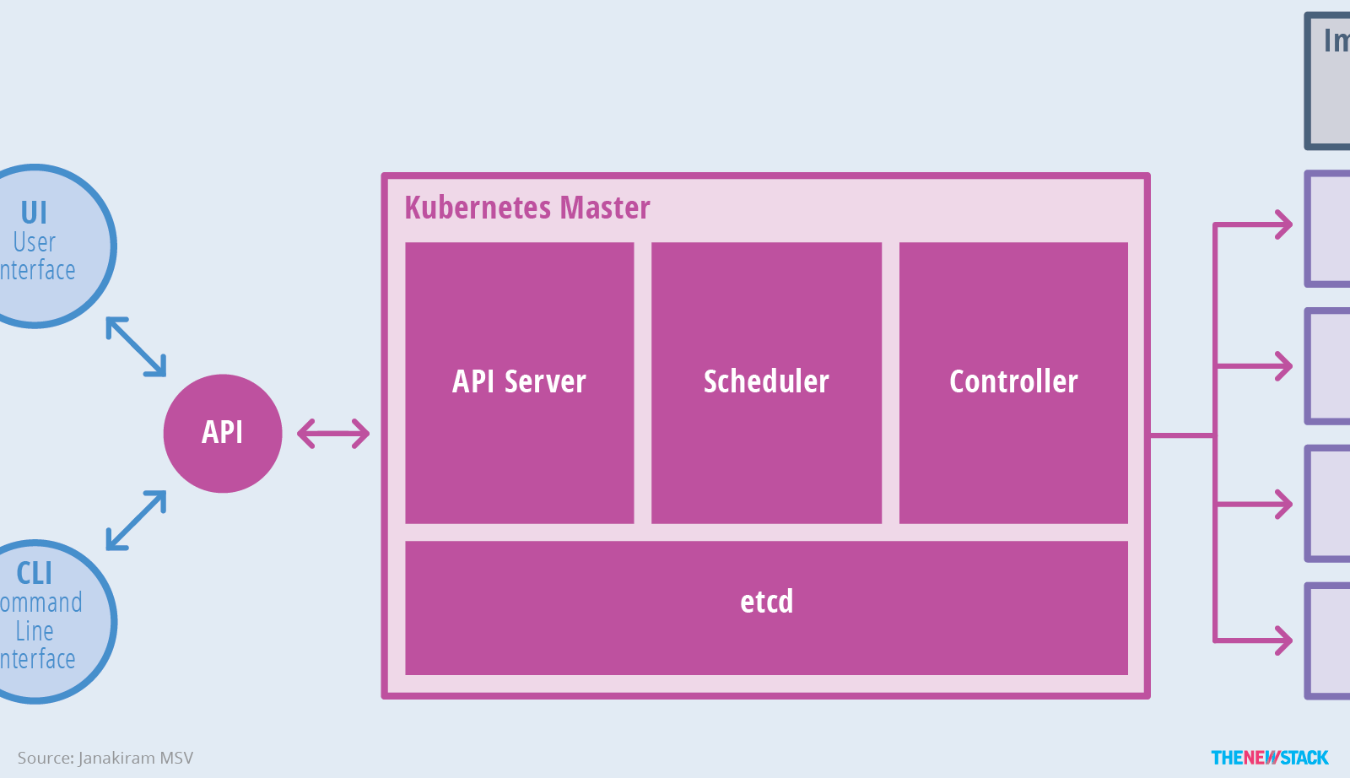
System Architecture
Ref: https://cdn.thenewstack.io/media/2016/11/Chart_02_Kubernetes-Architecture.png

Slide 46
System Architecture
Kubernetes Master
API Server: Interface for all UI to command that interact with kubernetes cluster
Scheduler (Job Dispatcher): Schedule all nodes’s resource and dispatching Pods to nodes with match criteria
CPU ?
Memory ?
Affinity / Constraing ?
Controller and Replication Controller (RC) : Control/Coordinate all nodes for maintain server as configure on cluster system
Etcd (Open-source): Key-value database for keep state of nodes/Pods/Container
Secret: Encrypt confidential data
HPA (Horizon Pods Auto scaling): Scale pods with CPU criteria (major)
Event: Keep log and event on cluster
NameSpace: Limit resource quota via define namespace (cpu, memory, pods etc)

Slide 47
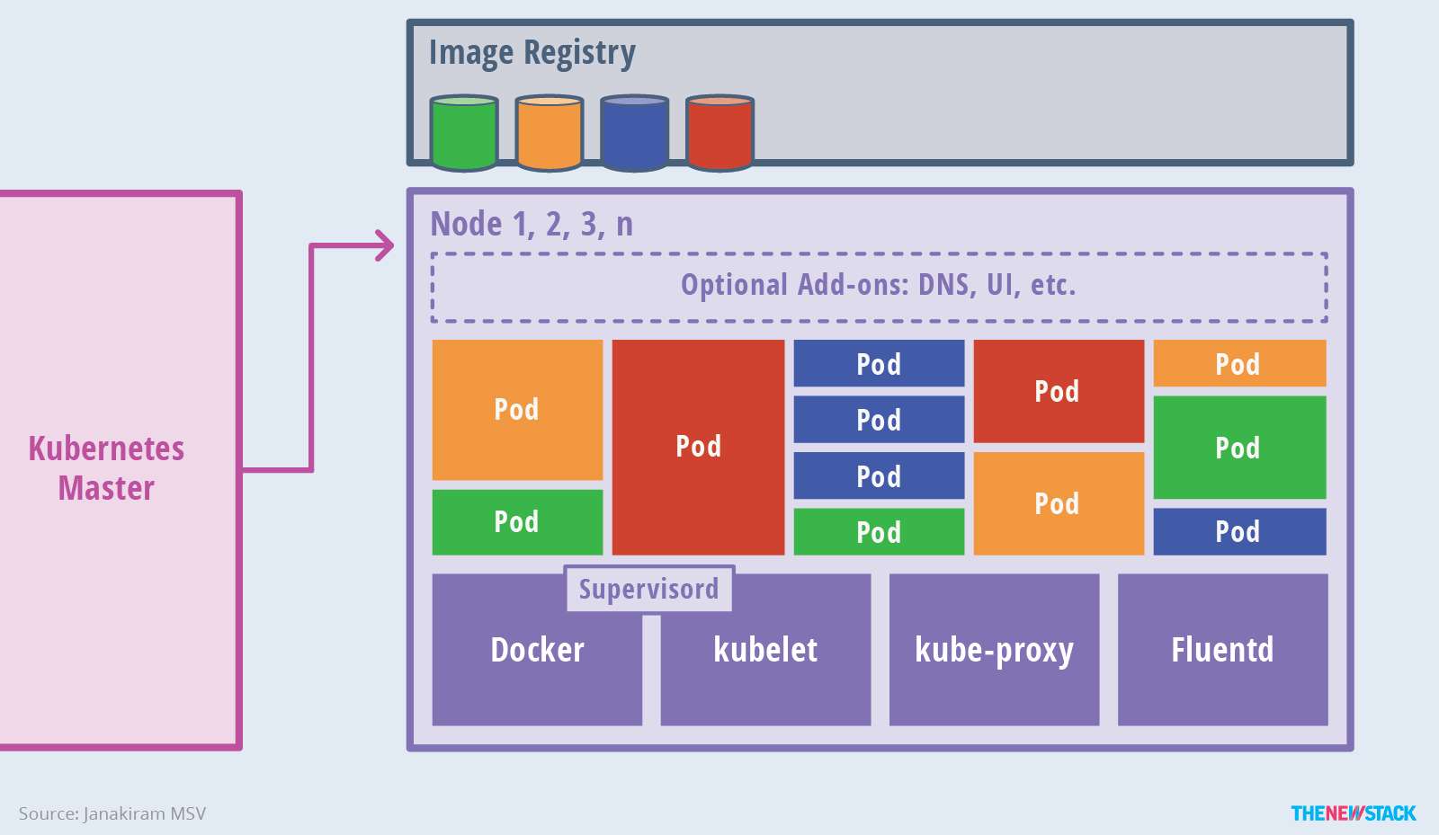
System Architecture
Ref: https://cdn.thenewstack.io/media/2016/11/Chart_02_Kubernetes-Architecture.png

Slide 48
System Architecture
Kubernetes Node
Pods: Pods is smallest deployable units of computing that can be created and manage in kubernetes (Pods != Container).
Docker: Docker engine for run container. Kubernetes support both docker and rkt (rocker)
Kubelet: Agent on node to talk with kubernetes master and send status/health of node
Supervisord (Docker+Kubelet): Process monitoring
Fluentd: Daemon for collect logs sent to kubernetes master
Kube-Proxy: Manage all network interface on node (Core network component)

Slide 49
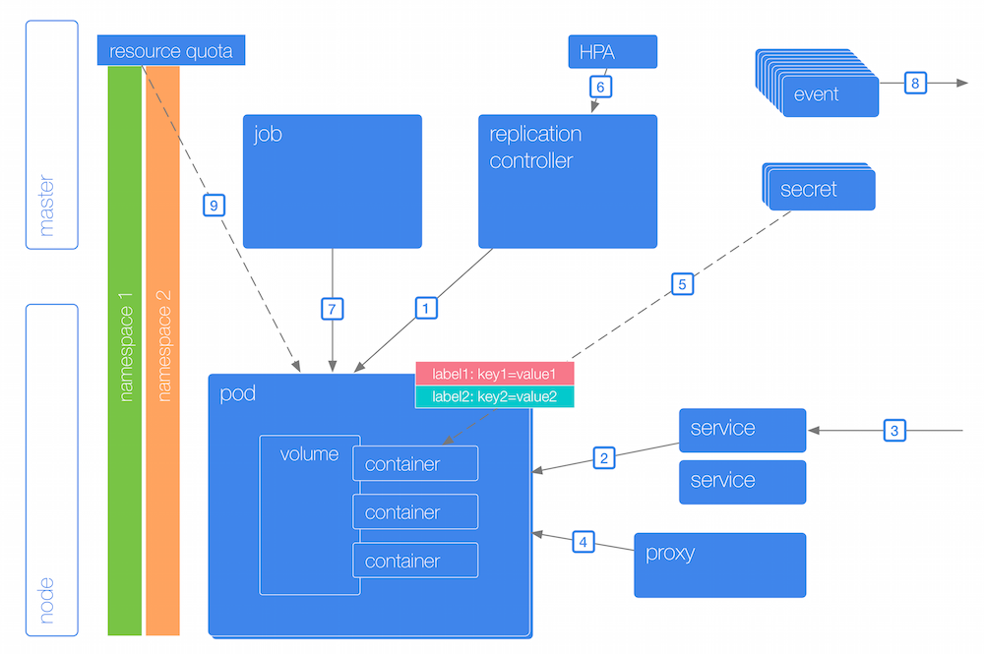
System Architecture
Ref: http://k8s.info/cs.html

Slide 50
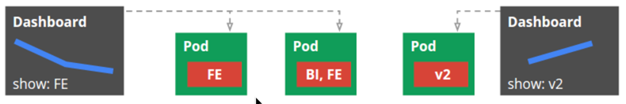
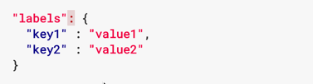
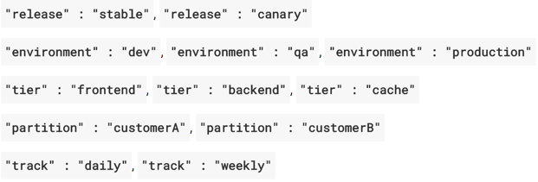
System Architecture

Slide 51

System Architecture
Ref: https://kubernetes.io/docs/user-guide/kubectl/v1.7/

Slide 52

Fundamental of Kubernetes

Slide 53
Pods, Container and Services

Slide 54
Pods, Container and Services
Pods vs Container
Docker’s view point:
1 Container: 1 Application, 1 Component of Microservice
So for micro service we need multi container
Cache component
Web component
Database component
Etc
Kubernetest’s view point:
1 Pods = 1 Container
1 Pods = N Container (Container on the same context, Work closely)
So we can have 1 Pods for container more than 1 container

Slide 55
Pods, Container and Services
Pods vs Container
All container on same Pods will share:
Process ID (PID)
Network access (Communicate to each other via “localhost”)
Internal Process Command (IPC)
Unix Time-Sharing (UTS)
Hostname
IP Address/Ports
Use Case for Multiple Pods:
Apache (1 Container) +Tomcat (1 Container)
Apache(1 Container) + PHP (1 Container)
Nginx (Cache: 1 Container) + Apache/PHP (1 Container)
Web Server (1 Container) + Data Volume(Cache: 1 Container)
Pods will can create replicas of 1000+ set on cluster system

Slide 56

Pods, Container and Services
Container/ Pods / Service / Deployment/ RS

Slide 57


Pods, Container and Services
Way to deploy object in kubenetes by kubectl
Imperative commands:
Ex: kubectl <action> <type/name> <option>
Ex: kubectl run webtest --image labdocker/nginx:latest
Imperative object configuration
Ex: kubectl <action> –f <YAML file>
Ex: kubectl create –f nginx.yml
Ex: kubectl replace –f nginx_update.yml
Declarative object configuration
Ex: kubectl apply –f <directory>

Slide 58

Pods, Container and Services
Imperative commands:
“kubectl run” (Pods + Deployment+ RC (Replicas))
Option:
--env=”key=value”
--port=port
--replicas=<number of Pods replicas>
--overrides=<json>
--labels=<label>
Etc
Example:
kubectl run –image=<image name> <option>

Slide 59
Pods, Container and Services
Imperative commands:
kubectl expose (Service)
Option:
--name=name
--port=port for service
--target-port=port of deployment set
--type=<NodePort/ClusterIP/LoadBalance>
--protocol=<TCP/UAT etc>
Etc
kubectl expose deployment <name> <option>

Slide 60

Pods, Container and Services
Imperative commands:

Slide 61

Pods, Container and Services
Imperative object configuration
Create Pods (YAML) Create Service (YAML)
kubectl create –f <Filename>

Slide 62

Pods, Container and Services

Slide 63

Pods, Container and Services
Imperative object configuration
kubectl create –f <Filename>

Slide 64

Pods, Container and Services
Imperative object configuration
kubectl create –f <Filename>

Slide 65


Pods, Container and Services
Check log on container:
Shell inside container:
kubectl logs <Pods name> –c <container name>
kubectl exec –it <Pods name> –c <container name> sh

Slide 66

Pods, Container and Services
Check detail property of Pods/Service
kubectl describe <Pods/SVC/etc> <Name>

Slide 67

Pods, Container and Services
Check detail property of Pods/Service
kubectl describe <Pods/SVC/etc> <Name>

Slide 68


Pods, Container and Services
Check overall of Pods/Service
Remove Pod/Service
kubectl get <Pods/SVC/etc>
kubectl delete –f <Filename>

Slide 69
Pods, Container and Services
Trade-offs
Imperative commands:
Advantage:
Simple & Easy
Single Step for All
Effective immediate real-time
Disadvantage:
Hard to review on complete deployment
Unable to track change of them/Store source of deployment
No template for reiteration
Very long syntax when facing with complex configuration

Slide 70
Pods, Container and Services
Trade-offs
Imperative object configuration
Advantage:
Deployment source can keep and review process (svn, git etc)
Provide formal template for deployment
No skill set required deployment process
Disadvantage:
Need to understand of kubernetes before use
Writing YAML file before operate
Lost configuration update when it not appear on file (Next replacement will lost)
Design for manage via file not directory

Slide 71

Pods, Container and Services
Trade-offs
Declarative object configuration
Advantage:
Coverage all change in single command (Entire folder)
Fully support live-object configuration
Keep track/Merge all change in configuration file
Update default value in configuration file
Disadvantage:
More complicate on configuration file

Slide 72
Workshop 1.2: Pods & Service
Part 1: Deploy simple web pods with single container
Port: 5000
Frontend Client
WebServer
Call Web

Slide 73
Pods, Container and Service
Example Case: Basic Restful API
Port: 5000
Port: 3306
Frontend Client
Restful WebService
Database
Call Web
Write/Read DB
Restful Json:
- Add
- Delete
- Show

Slide 74
Pods, Container and Service
Example Case: High I/O Restful API
Port: 80
Port: 3306
Frontend Client
Web Cache
Database
Restful Json:
- Add
- Delete
- Show
Write/Read DB
Call Web
Port: 5000
Restful WebService
Read Cache DB
Port: 6379
DB Cache

Slide 75


Pods, Container and Service
Restful WebService
/init
/insertuser

Slide 76

Pods, Container and Service
Restful WebService
/removeuser/<uid>

Slide 77

Pods, Container and Service
Restful WebService
/users/<uid>

Slide 78

Pods, Container and Service
Web Cache

Slide 79

Pods, Container and Service
Database and Database Cache
Mysql Database
Redis Key-Value Database

Slide 80



Pods, Container and Service
Setup container for test
docker-compose build --no-cache
docker-compose up –d
docker-compose start

Slide 81

Pods, Container and Service
How to test ?

Slide 82


Pods, Container and Service
How to test ?
Initial database
Insert database

Slide 83


Pods, Container and Service
How to test ?
Retrieve database/cache
Delete database

Slide 84
Pods, Container and Service
Pods: web
Pods: maindb
Port: 3306
Frontend Client
Web Cache
Database
Restful Json:
- Add
- Delete
- Show
Write/Read DB
Call Web
Port: 5000
Restful WebService
Read Cache DB
Port: 6379
DB Cache

Slide 85
Pods, Container and Service
Pods: web
Pods: maindb
localhost
Frontend Client
Port: 80
Port: 3306
Port: 30500
Port: 32500
Service
Web Cache
Service
Database
Port: 5000
Restful WebService
IP Cluster: 10.0.0.X
Name: maindb
Service Port: 3306 (port)
Container Port: 3306 (target port)
NodePort: N/A (Cluster IP)
Request:
http://192.168.99.101:30500
http://192.168.99.101:32500
Port: 6379
DB Cache
IP Cluster: 10.0.0.X
Name: maindb
Service Port: 80,5000(port)
Container Port: 80,5000(target port)
NodePort: 30500⬅➔80 (TCP)
32500⬅➔5000 (TCP)
Minikube: 192.168.99.101

Slide 86
Pods, Container and Service
Web Cache
Docker Commit
labdocker/cluster:
webcache_kubenetes
Restful WebService
labdocker/cluster:webservice
Docker Commit
Database
Docker Commit
labdocker/mysql:latest
DB Cache
Docker Commit
labdocker/redis:latest

Slide 87


Pods, Container and Service
Pods: maindb(YML) Service: maindb(YML)

Slide 88


Pods, Container and Service
Pods: web(YML) Service: web (YML)

Slide 89

Pods, Container and Service
Create ”maindb” Pods and service

Slide 90


Pods, Container and Service
Create “web” Pods and service

Slide 91


Pods, Container and Service
Initial database and insert data

Slide 92

Pods, Container and Service
Initial database,insert and get data (Direct/Cache)

Slide 93


Pods, Container and Service
Delete data (Both cache and database)
Remove

Slide 94
Pods, Container and Services
Services
Service is independent from Pods
Pods is can create / destroy / restart every time (manual/automatic)
Mean “Pods” always change their nodes/ip/location everytime
Service don’t care how Pods is being, But they still can map the Pods
Service is abstract of Pods (1 – N Pods)
Usually defined port by “Label”
Expose access Pods/Load Balance with service (kube-proxy: iptables)
“port” that service open for access
“target port” that map with Pods for access
“type” TCP/UDP
Discovery service option:
ENVIRONMENT:
{SVC_NAME_SERVICE_HOST}
{SVC_NAME_SERVICE_PORT}
DNS (cluster-addon): Name same service name

Slide 95



Pods, Container and Services
Services
Pods “web” Pods “web2” Service “web”

Slide 96


Pods, Container and Services
Services
Existing Pods “web”

Slide 97

Pods, Container and Services
Services
Replace new Pods “web2”

Slide 98
Pods, Container and Services
Services
Publish Service Type:
CLUSTER-IP (Default): blind port with ip addess of cluster (Accessible from internal cluster system)
NodePort: blind port with ip address of node. By default kubernetes will random port (30000-32757). If we need to specify set the option: “nodePort: XXXXX”

Slide 99

Pods, Container and Services
Services
Publish Service Type:
External LoadBalance (Usually from cloud provider): service will allow loadbalance send traffic through Pods directly

Slide 100

Pods, Container and Services
Services
Publish Service Type:
External Ips: Specific external IP need to set-up from network equipment (L3 Switch/Firewall/F5 etc) to forward traffic to kubernetes’s nodes (Not IP Address of node)

Slide 101
Workshop 1.2: Pods & Service
Part 2: Deploy web pods with multi container
Port: 30500
Port: 32500
Port: 3306
Frontend Client
Web Cache
Database
Restful Json:
- Add
- Delete
- Show
Write/Read DB
Call Web
Pods: maindb
Port: 5000
Restful WebService
Read Cache DB
Port: 6379
DB Cache
Pods: web

Slide 102

Pods, Container and Services
Other Command
Ref https://kubernetes.io/docs/user-guide/kubectl/v1.7

Slide 103
Daemon Set and RC

Slide 104
Daemon Set and RC
What is Daemon Set
On basic pods and service can make microservice up and run!
But…
No maintain about available of Pods
Not response Pods scaling
Etc
Daemon Set will response:
Make sure that Pods run on all (or some) node in cluster
When node add to cluster. Pods will deploy automatic
When node remove, GC will automatic remove Pod
When remove Daemon Set, Pods will automatic remove
General Use Case
Storage Daemon (Ceph etc)
Node Monitor Daemon (Prometheus Agent etc)

Slide 105
Daemon Set and RC

Slide 106
Replication Controller (RC)
What is RC
Daemon Set and Replication Controller is work similar.
RC (Replication Controller) will response:
Create/Maintain Pods as ”Replication Controller” (Pods Farm)
Keep copy of Pods (Replicas) as design
Ensure that Pods is up and run with amount like design
If too much, It will kill some Pods
If too kill, It will create another replicas of Pods
Auto healing if some Pods crash with any reason
Maintenance on cluster-level not node level

Slide 107

Replication Controller (RC)
Replication Controller (RC)
RC is first version of module to maintain Pods available in cluster
Use Case…
Rescheduling
Scaling
Rolling updates (Complicate)
Map with service for manage release
RC is running base on label type: “Equality-based requirement”
Ex:

Slide 108



Replication Controller (RC)
Example
Pods “webtest” RC “webtest” SVC “webtest”

Slide 109



Replication Controller (RC)
Create rc “webtest”
Create svc “webtest”

Slide 110


Replication Controller (RC)
Test delete some Pods from command line
Recheck Pods unit and available

Slide 111

Replication Controller (RC)
Check detail of create process on RC

Slide 112


Replication Controller (RC)
Scale up replicas on RC
kubectl scale <option> --replicas <Type/Name>

Slide 113

Replication Controller
Check detail of create process on RC

Slide 114
Replication Controller
Test delete some Pods from command line
Recheck Pods unit and available

Slide 115

Replication Controller
Cleanup Lab

Slide 116
Workshop 1.3: RC
Deploy replication controller

Slide 117
Deployment/RS and Update

Slide 118
Deployment/RS and Update

Slide 119
Deployment/RS and Update
What is deployment/RS?
Deployment and RS (ReplicaSet) is set “next-generation of RC” by provide full function to maintain versioning of Pods in production (No downtime: On-the-fly)
Update new version (Rollout)
Revert old version (Rollback)
Pause/Resume process
Check status
By design deployment will order job to ReplicaSet(RS) for create Pods as design for up and run
When new version was rollout from deployment (Automatic)
Create new RS and start to scale as desired
Scale down existing RS to 0
Delete existing RS

Slide 120

Deployment/RS and Update
ReplicaSet(RS) vs Replication Controller (RC)
RS is generation that evolution from RC with capability more dynamic
RC support label with method “Equality-based requirement”
RS support label with method “Equality-based requirement” and “Set-based requirement”

Slide 121



Deployment/RS and Update
Example
labdocker/cluster:webservicelite_v1
labdocker/cluster:webservicelite_v1.51rc
labdocker/cluster:webservicelite_v1.8ga

Slide 122

Deployment/RS and Update
Example
Deployment “webtest” SVC “webtest”

Slide 123


Deployment/RS and Update
Create deployment “webtest” and ReplicaSet (RS)
Create svc “webtest”

Slide 124


Deployment/RS and Update
Procedure for deployment operate
Check existing RS (0 when create new)
Create new RS
Scale RS to designed replicas

Slide 125

Deployment/RS and Update
Deployment update strategy (Rollout)
Update will start trigger when some of “spec:template” is changed
Step for produce update (rollout) with Each Change
Scale down existing RS to 1 (1 max unavailable)
Create new RS for template change
Scale new RS as designed (No more than design +1: 1 max surge)
Delete existing RS

Slide 126
Deployment/RS and Update
Deployment update strategy (Rollout)
YAML File
create rs
scale up
ReplicaSet: webtest-deployment-1x9
Name: webtest
….
Scale=3
….
Image: v1
create -f
Pods1: webtest-deployment-1x9-2323
Pods2: webtest-deployment-1x9-8382
Pods3: webtest-deployment-1x9-2272
Deployment
YAML File (Update)
scale down to 0
ReplicaSet: webtest-deployment-1x9
Name: webtest
….
Scale=3
….
Image: v2
apply -f
drop rs
Pods1: webtest-deployment-1x9-2323
Pods2: webtest-deployment-1x9-8382
Pods3: webtest-deployment-1x9-2272
Deployment
ReplicaSet: webtest-deployment-1YU
create rs
scale up
Pods1: webtest-deployment-1YU-4323
Pods2: webtest-deployment-1YU-6782
Pods3: webtest-deployment-1YU-2372

Slide 127
Deployment/RS and Update
Deployment update strategy (Rollout)
Trigger Change on Deployment
Method1: Set online
Ex: kubectl set image deployment/webtest webtest:betaversion
Method2: Edit online
Ex: kubectl edit deployment/webtest
Method3: Edit YAML File and Apply
kubectl set <Property> <Type/Name> Variable=Value
kubectl edit <Type/Name>
Edit file <FileName> .YML
kubectl apply –f <FileName>

Slide 128
Deployment/RS and Update
Check status of deployment’s update (rollout)
Use “rollout” utility
Ex:
Check status of rollout process:
kubectl rollout status deployment/webtest
Check history of rollout process:
Kubectl rollout history deployment/webtest
Rollback rollout process:
kubectl rollout undo deployment/webtest --to-revision=2
Pause/Resume process:
kubectl rollout pause/resume deployment/webtest
kubectl rollout <Option> <Type/Name>

Slide 129


Deployment/RS and Update
Deployment update strategy
Set new image on deployment
Rollout History

Slide 130


Deployment/RS and Update
Deployment update strategy
Rollback process
Rollout History

Slide 131

Workshop 1.4: Deployment/RS
Deploy replication controller

Slide 132
Resource Management and HPA

Slide 133
Resource Management and HPA
Ref: http://k8s.info/cs.html

Slide 134
Resource Management and HPA
Kubernetes can manage resource in 2 ways
Container level configuration
Scope on Container unit independence
Use in case experiment/test purpose
etc
Namespace level configuration
Scope on Pods and Container level
Create global limit and assign to namespace
Apply namespace to any Pods (Template Resource Limit)
What happen when Container resource exceed ?
CPU
Container will not get CPU as it need and the free-slot of CPU was distributed to all container’s request with ratio
Memory
Container was killed and restart it again

Slide 135
Resource Management and HPA
Container level configuration
CPU
Request:
XXXm(Unit: millicores) (Ratio: 1024)
0.1= 100m
1 CPU =
1 vCPU (AWS)
1 GCP (Google Cloud)
1 Azure v Core
1 Hyper thread (Bare Meterial)
Consider as “--cpu-share”
Limit:
XXXm(Unit: millicores) (Ratio:100000/1000: ~1000)
Consider as “--cpu-quota”
Memory
Request:
XXX (Unit:Ki, Mi, Gi, Pi, Ei)
Limit
XXX (Unit:Ki, Mi, Gi, Pi, Ei)
Ref: https://github.com/kubernetes/community/blob/master/contributors/design-proposals/resource-qos.md

Slide 136


Resource Management and HPA
Container level configuration
Pods “webtest” System status

Slide 137

Resource Management and HPA
Container level configuration
Allocate status on node

Slide 138


Resource Management and HPA
Container level configuration
Create Load on CPU (T1)
System status

Slide 139


Resource Management and HPA
Container level configuration
Create Load on CPU (T2)
System status

Slide 140
Workshop 1.5: Resource MNG/HPA
Part 1: Container level configuration

Slide 141
Resource Management and HPA
Namespace level configuration
Name space provide collection of resource of cluster system that easy to defined and apply to object in cluster system
Name space can apply with
Pods
Services
Replication Controller
Deployment and ReplicaSets
Quota
LimitRange
Etc
For resource management resource in name space level. We will use Quota and LimitRange
Quota: Summary of resource control on name space
LimitRange: Resource admission control/Default resource define
etc

Slide 142

Resource Management and HPA
Quota
Compute resource
CPU
Limits
Request
Memory
Limits
Request
Disk I/O
PersistenctVolumeClaims
Request.Storage
Counting Object
Pods
Service
Replication Controller
ConfigMap
Secrets
Ref: https://kubernetes.io/docs/concepts/policy/resource-quotas

Slide 143

Resource Management and HPA
LimitRange
Type: (Pods/Container)
Max
CPU:
Memory:
Min
CPU
Memory
Default (Limit Default for Container)
CPU
Memory
DefaultRequest (Default for Container)
CPU
Memory
Ref: https://kubernetes.io/docs/tasks/administer-cluster/apply-resource-quota-limit/

Slide 144

Resource Management and HPA
Create Namespace, assign quota with name space
kubectl create namespace <name>
kubectl create –f <Quota File> -- namespace <name>
Ref: https://kubernetes.io/docs/concepts/policy/resource-quotas

Slide 145


Resource Management and HPA
Deployment

Slide 146

Resource Management and HPA
Create Deployment and check result
kubectl create –f <Deployment File> --namespace <name>

Slide 147

Resource Management and HPA
Why it fail ?
kubectl describe rs --namespace <name>

Slide 148

Resource Management and HPA
Create LimitRange and check result
kubectl create –f <LimitRange File> --namespace <name>

Slide 149

Resource Management and HPA
Recreate Deployment and check result

Slide 150

Resource Management and HPA
Check describe of Pods
kubectl describe pods --namespace <name>

Slide 151

Resource Management and HPA
Test burn cpu utilize and monitor

Slide 152

Resource Management and HPA
Edit deployment for update cpu/memory Limits,request

Slide 153


Workshop 1.5: Resource MNG/HPA
Part 2: Namespace level configuration

Slide 154
Resource Management and HPA
Horizontal Pod Autoscaling (HPA)
The scale is easy to operate with ”kubectl scale --replicas=XXX deployment/<name>” with single command
But..
How can you scale meet up/down actual required ?
HPA will response for monitor workload on Pods (Now base on CPU) and automatic trigger deployment to scale-up application
Ex: kubectl autoscal deployment/webtest --min=1--max=10 --cpu-percent=80
kubectl autoscale <type/name> <option:>

Slide 155
Recap Day 1
Container concept (Recap)
Introduction to Kubernetes
System Architecture
Fundamental of Kubernetes
Pods, Container and Services
Replication Controller (RC)
Deployment/Replica-Set (RS) and Rolling update
Resource Management and Horizontal Pods Autoscaling (HPA)

Slide 156
Outline Day 2
Fundamental of Kubernetes (Con’t)
Map and Secret
Jobs and Cron Jobs
Debug Log and Monitoring
Ingress Networking
Kubernetes in real world
Cluster Setup for Bare Metal
Orchestrator Assignment
nodeSelector
Interlude
Affinity
Taints/Tolerations

Slide 157

Question & Answer Section

Slide 158
Kubernetes 101: Production-Workload Orchestration
Day 2

Slide 159
Outline Day 2
Ingress Network
Kubernetes in real world
Cluster Setup for Bare Metal
Orchestrator Assignment
nodeSelector
Interlude
Affinity
Taints/Tolerations
Stateful application deployment
Consideration and Awareness
Volumes and Persistent Volumes
PetSets and StatefulSets
Cluster Administration

Slide 160
Ingress Network

Slide 161
ConfigMap and Secret

Slide 162
ConfigMap and Secret
Make secret data and configuration great again !
Many container need some configuration/potential data for make it work. But is it should store in image/configuration (Container,Pods, Deployment, RC etc)?
Root password of database
Environment variable
Custom variable
Path of mount volume data
Etc
ConfigMap will provide central configuration for Pods operate
Secret will encode sensitive data for keep secret

Slide 163

ConfigMap and Secret
ConfigMap
ConfigMap belong to namespace scope
Option to create:
literal values
From file or folder
YAML file
Ex: “kubectl create configmap webmodule_configmap --from-literal=REDIS_HOST=localhost”
Ex: “kubectl create –f webmodule_configmap.yml”
kubectl create configmap <name> <option>

Slide 164


ConfigMap and Secret
Secret
ConfigMap will encode64 algorithm
Option to create:
From file <store confidential value>
YAML file
Ex: “kubectl create secret generic databasemodule_secret --from-file=./username.txt --from-file=./password.txt”
Ex: “kubectl create -f databasemodule_secret.yml”
kubectl create secret generic <name> <option>

Slide 165
ConfigMap and Secret
Pods: web
Pods: maindb
localhost
Frontend Client
Port: 80
Port: 3306
Port: 30500
Port: 32500
Service
Web Cache
Service
Database
Port: 5000
Restful WebService
IP Cluster: 10.0.0.X
Name: maindb
Service Port: 3306 (port)
Container Port: 3306 (target port)
NodePort: N/A (Cluster IP)
Request:
http://192.168.99.101:30500
http://192.168.99.101:32500
Port: 6379
DB Cache
IP Cluster: 10.0.0.X
Name: maindb
Service Port: 80,5000(port)
Container Port: 80,5000(target port)
NodePort: 30500⬅➔80 (TCP)
32500⬅➔5000 (TCP)
Minikube: 192.168.99.101

Slide 166



ConfigMap and Secret
Pods.yml: databasemodule_pod.yml
Port: 3306
Service
Database
localhost
Port: 80
Service
Web Cache
Port: 5000
Restful WebService
Sourcecode: main.py
Port: 6379
Pods.yml: webmodule_pod.yml
DB Cache

Slide 167


ConfigMap and Secret
Deploy.yml: databasemodule_deploy_config.yml
Port: 3306
Service
Database
Secret.yml: databasemodule_secret.yml

Slide 168


ConfigMap and Secret
Secret.yml:
databasemodule_secret.yml
Deploy.yml:
webmodule_deploy_config.yml
ConfigMap.yml:
webmodule_configmap.yml
Port: 5000
Service
Restful WebService

Slide 169


Workshop 2.1: ConfigMap and Secret

Slide 170
Job and Cron Jobs

Slide 171
Job and Cron Job
Some task on kubernetes will batch process or non-interactive job
Update EOD Process
Monitor System Health
Calculate Balance
Run reindexing file/database
etc
“Job” on kubernetes was design to operate special purpose
Job will track status of complete job
Job will autostart new Pods when it failed or deleted
Job will delete Pods when job was deleted
kubectl create –f <YAML File>

Slide 172




Job and Cron Job
Job.yml: job.yml

Slide 173



Workshop 2.2: Job and CronJob
Task0: Generate LINE token
https://notify-bot.line.me

Slide 174



Workshop 2.2: Job and CronJob

Slide 175

Workshop 2.2: Job and CronJob
Task1: Create Jobs for Monitor System via LINE
TITLE: ➔ Input Name
INTERVAL : ➔ Input Check Interval (ms)
HEAP_HIGH: ➔ % of Heap Memory Warn
MEM_HIGH: ➔ % of Memory Used Warn
SH_OS: ➔ Mode
(Show information:Y, Show only Warning Reach:N)
TOKEN: ➔ Input LINE TOKEN

Slide 176


Job and Cron Job
“CronJob” is time base “Jobs” with
Run on specific point-in-time
Repeat point in time
etc

Slide 177
Debug Log and Monitoring

Slide 178
Debug Log and Monitoring
Normally kubernetes provide tool for check log on Pods and container level with several option
Option:
-p, --previous=false ➔ Printout last container fail in Pods
-f, --follow=false ➔ Follow stream log
-c, --container ➔ Specific container for check log
-l, --selector ➔ Select filter some label for check log
Ex:
kubectl logs -f pods/maindb –c maindb
kubectl logs pods/<pods name> -c <container name> <option>

Slide 179


Debug Log and Monitoring
Monitoring kubernetes system via dashboard
minikube dashboard

Slide 180

Workshop 2.3: Log and Monitoring

Slide 181
Ingress Network
Remember Service ?
Service will expose for other Pods / External to connect and access service on Pods inside
Service quite limit and non flexible for operate
How to handle for multiple service on same port ?
How to limit protocol for access ? (HTTP/HTTPS/FTP etc)
How to blinding with hostname ? (www.xxxx.yyy)
How to TLS connection ?
etc
Ingress is tool will operate for that
Give some customize label for classify host and define some selector criteria for specific node run Pods

Slide 182
Ingress Network
Service:
Pods: loadbot
Curl http://x.x.x.x:80
Port: 80
Port: 5000
Service
Pods: webtest1
Curl http://y.y.y.y:80
Cluster IP: X.X.X.X
Port: 80
Port: 5000
Service
Pods: webtest2
Cluster IP: Y.Y.Y.Y
Frontend Client
Port: 30500
NodePort
Port: 80
Port: 5000
Service
Pods: webtest1
Port: 32500
Cluster IP: X.X.X.X
Port: 5000
Port: 80
Service
Pods: webtest2
Request:
http://192.168.99.101:30500
http://192.168.99.101:32500
Cluster IP: Y.Y.Y.Y

Slide 183


Ingress Network
Ingress:
Frontend Client
Port: 80
Port: 5000
Ingress
Service
Pods: webtest1
Ingress Configuration:
http://webtest1.kuberneteslabthailand.com ➔ webtest1 (service)
http://webtest2.kuberneteslabthailand.com ➔ webtest2 (service)
Cluster IP: X.X.X.X
Port: 80
Port: 5000
Service
Pods: webtest2
Cluster IP: Y.Y.Y.Y

Slide 184



Ingress Network
SVC: webtest1
Ingress: ingresswebtest
SVC: webtest2

Slide 185



Ingress Network
Ingress (TLS):
Frontend Client
Port: 80
Port: 5000
Ingress
Service
Pods: webtest1
Ingress Configuration:
https://webtest1.kuberneteslabthailand.com ➔ webtest1 (service)
https://webtest2.kuberneteslabthailand.com ➔ webtest2 (service)
Cluster IP: X.X.X.X
Port: 80
Port: 5000
Service
Pods: webtest2
Cluster IP: Y.Y.Y.Y

Slide 186

Ingress Network

Slide 187



Ingress Network
SVC: webtest1
Ingress: ingresswebtest
Secret: webtest1
SVC: webtest2
Secret: webtest2

Slide 188
Workshop 2.4: Ingress Network
Frontend Client
Port: 80
Port: 5000
Ingress
Service
Pods: webtest1
Ingress Configuration:
http://webtest1.kuberneteslabthailand.com ➔ webtest1 (service)
http://webtest2.kuberneteslabthailand.com ➔ webtest2 (service)
Cluster IP: X.X.X.X
Port: 80
Port: 5000
Service
Pods: webtest2
Cluster IP: Y.Y.Y.Y

Slide 189
Kubernetes in real world

Slide 190
Kubernetes in real world
Kubernetes have a lot of component need to install / configuration on real world
Normally kubernetes need some 3rd tool for deployment
Ubuntu(MAAS, JUiu)
CoreOS
Fedora (Ansible)
provide new solution for create cluster system with kubernetes orchestrator
Option:
--apiserver-advertise-address= x.x.x.x (Default: First Interface)
--apiserver-bind-port = xxx (Default: 6443)
--kubernetes-version = xxx (Default: latest)
--pod-network-cidr = x.x.x.x (CNI), Need for Flennel
--token = xxxx (Default: auto gen)
--skip-preflight-checks
etc
kubeadm <init>

Slide 191
Kubernetes in real world
Kubernetes have a lot of component need to install / configuration on real world
Normally kubernetes need some 3rd tool for deployment
Ubuntu(MAAS, JUiu)
CoreOS
Fedora (Ansible)
Since kubernetes 1.6 and later. Cluster system can make with command “kubeadm”
Prerequisite
Docker Engine
Kubernetes Engine (Kubelet, Kubectl, Kubeadm)
Role of the cluster system
Master:
Control all activity on cluster system (Pods, Services, Job, CronJob, RS, RC etc)
Node:
Worker for running as Master’s order

Slide 192
Kubernetes in real world
Create cluster from bare metal
Step for setup
Phase 1: Install prerequisite component
Docker Engine
Kubelet Engine
Kubeadm Engine
Phase 2: Initialize Master node
kubeadm init <option>
Phase 3: Install Pods Network (3rd party) with CNI support
Flannel (Support Cross-Platform)
Weave Net (Support Cross-Platform)
Calico
Canal (Flannel + Calico)
Contiv
Romana
Etc
Phase 4: Join node to cluster system
kubeadm join <option>

Slide 193




Kubernetes in real world
Network Optional
http://engineering.skybettingandgaming.com/2017/02/03/overlay-network-performance-testing/

Slide 194


Kubernetes in real world
Issue on Kubernetes 1.7.1
https://github.com/kubernetes/kubeadm/issues/344#issuecomment-316109138

Slide 195
Kubernetes in real world
Initial Master role
Option:
--apiserver-advertise-address= x.x.x.x (Default: First Interface)
--apiserver-bind-port = xxx (Default: 6443)
--kubernetes-version = xxx (Default: latest)
--pod-network-cidr = x.x.x.x (CNI), Need for Flennel
--token = xxxx (Default: auto gen)
--skip-preflight-checks
Etc
Join Node in Cluster
Option:
--apiserver-advertise-address= x.x.x.x (Default: First Interface)
--apiserver-bind-port = xxx (Default: 6443)
--kubernetes-version
kubeadm <init>
kubeadm <init>

Slide 196

Kubernetes in real world
Phase 1: Install prerequisite component

Slide 197


Kubernetes in real world
Phase 2: Initialize Master node

Slide 198


Kubernetes in real world
Phase 3: Install Pods Network (3rd party) with CNI support

Slide 199


Kubernetes in real world
Phase 4: Join node to cluster system

Slide 200

Workshop 2.5: Kubernetes Lab
Machine: Kubernetes_MS
Machine: Kubernetes_1
Machine: Kubernetes_2
Kubectl
Role: Node
IP Address: 192.168.99.200
vCPU: 4
Memory: 2 GB
Role: Node
IP Address: 192.168.99.201
vCPU: 4
Memory: 2 GB
Role: Node
IP Address: 192.168.99.202
vCPU: 4
Memory: 2 GB
Command/Monitor
Gcloud
Role: Client

Slide 201
Orchestrator Assignment

Slide 202
Orchestrator Assignment
Kubernetes have several way for control/restrict pod to run on nodes
nodeSelector
Give some customize label for classify host and define some selector criteria for specific node run Pods
Interlude
Build-in labels with nodes
kubernetes.io/hostname
failure-domain.beta.kubernetes.io/zone
failure-domain.beta.kubernetes.io/region
beta.kubernetes.io/instance-type
beta.kubernetes.io/arch
Affinity
Node Affinity
Inter-Pods Affinity and Anti-Affinity
Taints and tolerations

Slide 203




nodeSelector
Nodes: kubernetes-ms, kubernetes-1, kubernetes-2
Pods YAML File:

Slide 204


nodeSelector

Slide 205

Interlude
Nodes: kubernetes-ms, kubernetes-1, kubernetes-2
Pods YAML File:

Slide 206

Interlude

Slide 207
Affinity
Node Affinity
Similar to “nodeSelector” but more flexible for selection
requiredDuringSchedulingIgnoredDuringExecution (Hard)
preferredDuringSchedulingIgnoredDuringExecution (Soft)
If Pods was define both “nodeSelector” and “Affinity”. It need to satisfy both for operate
Inter-pod Affinity and Anti-affinity
“based on labels on pods (X) that are already running on the node with criteria (Y)"
Add constrain/dependence from Pods
podAffinity (Run with existing pods)
podAntiAffinity (Not run with existing pods)
Criteria(Y) will consider as “topologyKey”
Ex:
Run pods (podAffinity) on any node with same hostname (topologyKey (Y)=hostname) with existing pods that label “environment=development” (X)

Slide 208

Node Affinity
Pods YAML File:

Slide 209

Inter-pod Affinity and Anti-affinity
Pods YAML File:
“Run Pods on any node that have existing pods with key (environment=development) on node same hostname”
“Don’t run Pods on any node that have existing pods with key (module=DBServer) on node same storage type”

Slide 210
Affinity
Node Affinity
Similar to “nodeSelector” but more flexible for selection
requiredDuringSchedulingIgnoredDuringExecution (Hard)
preferredDuringSchedulingIgnoredDuringExecution (Soft)
If Pods was define both “nodeSelector” and “Affinity”. It need to satisfy both for operate
Inter-pod Affinity and Anti-affinity
“based on labels on pods (X) that are already running on the node with criteria (Y)"
Add constrain/dependence from Pods
podAffinity (Run with existing pods)
podAntiAffinity (Not run with existing pods)
Criteria(Y) will consider as “topologyKey”
Ex:
Run pods (podAffinity) on any node with same hostname (topologyKey (Y)=hostname) with existing pods that label “environment=development” (X)

Slide 211
Taint and Tolerations
Node side consideration
Force/Repel Pods from Node
Taint will apply to Node for protect “node” to run any pods without “tolerate” match taint
Tolerations apply to Pods for suggest (Not required) Pods to schedule
Use Case:
Dedicated Node / Maintenance Node
Special Hardware Node

Slide 212

Taint and Tolerations
Taint on Node:
Pods YAML File:
Tolerations:
Key=“dedicated”
Operator=“Equal”
Value=“Admin”
Effect=“NoSchedule”

Slide 213
Workshop 2.6: Orchestrator Assignment
Machine: Kubernetes_MS
Machine: Kubernetes_1
Machine: Kubernetes_2
Kubectl
Role: Node
IP Address: 192.168.99.200
vCPU: 4
Memory: 2 GB
Role: Node
IP Address: 192.168.99.201
vCPU: 4
Memory: 2 GB
Role: Node
IP Address: 192.168.99.202
vCPU: 4
Memory: 2 GB
Label: storage = M2
Label: storage = SSD
Label: storage = SAS
Lab Section:
Part 1: nodeSelector
Part 2: Interlude
Part 3: Affinity (Node)
Part 4: Inter-Pod Affinity and Anti-affinity
Part 5: Taint and Tolerations
Command/Monitor
Gcloud
Role: Client

Slide 214
Question & Answer Section

